Slide 1
Malignant-Comments-Classifier PPT
A PowerPoint presentation containing problem statement and understanding, EDA steps and visualizations, Steps and assumptions used to complete the project, model dashboard, finalized model, and conclusion.

Slide 2
Problem Statement
The proliferation of social media enables people to express their opinions widely online. However, at the same time, this has resulted in the emergence of conflict and hate, making online environments uninviting for users. Although researchers have found that hate is a problem across multiple platforms, there is a lack of models for online hate detection. Online hate, described as abusive language, aggression, cyberbullying, hatefulness and many others has been identified as a major threat on online social media platforms. Social media platforms are the most prominent grounds for such toxic behaviour.
There has been a remarkable increase in the cases of cyberbullying and trolls on various social media platforms. Many celebrities and influences are facing backlashes from people and have to come across hateful and offensive comments. This can take a toll on anyone and affect them mentally leading to depression, mental illness, self-hatred and suicidal thoughts. Internet comments are bastions of hatred and vitriol. While online anonymity has provided a new outlet for aggression and hate speech, machine learning can be used to fight it. The problem we sought to solve was the tagging of internet comments that are aggressive towards other users. This means that insults to third parties such as celebrities will be tagged as unoffensive, but “u are an idiot” is clearly offensive.
Our goal is to build a prototype of online hate and abuse comment classifier which can used to classify hate and offensive comments so that it can be controlled and restricted from spreading hatred and cyberbullying.

Slide 3
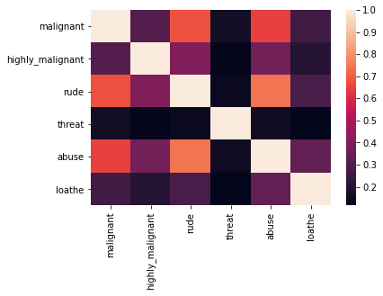
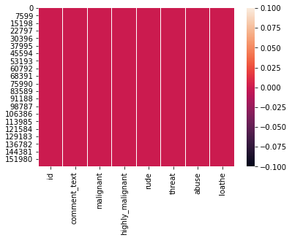
Data Visualization

Slide 4
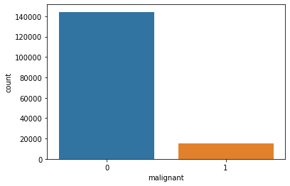
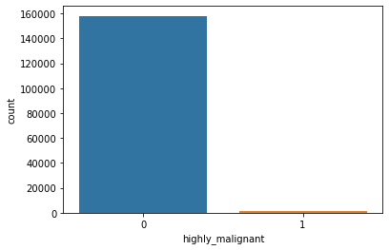

Slide 5
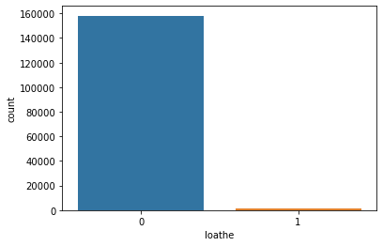
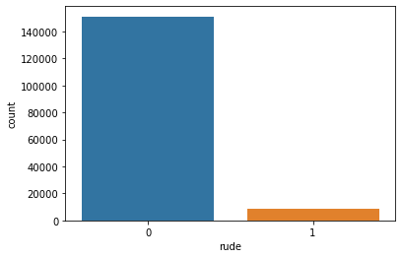

Slide 6
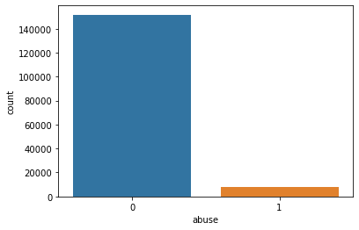


Slide 7
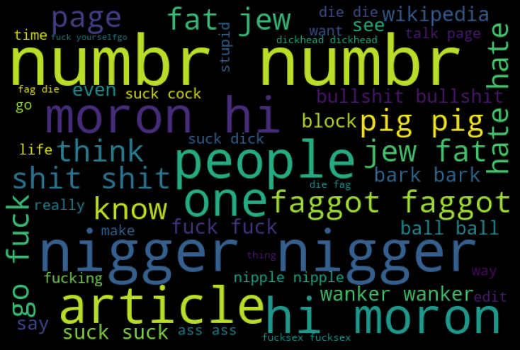
Offensives Loud Words

Slide 8
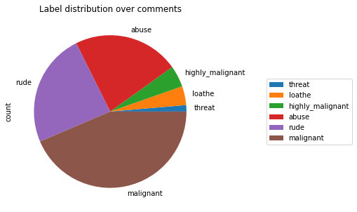
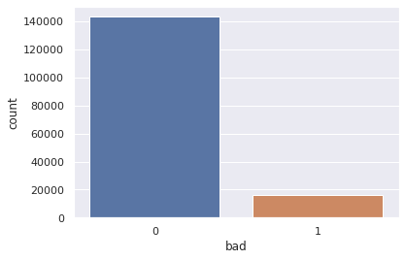

Slide 9
Model’s Training
Model’s used for the classification and regression

Slide 10
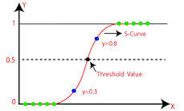
1. Logistic Regression Model –
Logistic regression is one of the most popular Machine Learning algorithms, which comes under the Supervised Learning technique. It is used for predicting the categorical dependent variable using a given set of independent variables. Logistic regression predicts the output of a categorical dependent variable.
Logistic regression is a supervised learning classification algorithm used to predict the probability of a target variable. The nature of target or dependent variable is dichotomous, which means there would be only two possible classes.

Slide 11
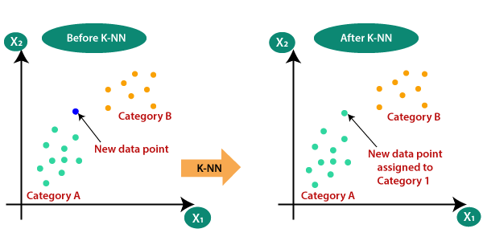
2. KNeighborsRegressor -
This algorithm is used for Classification and Regression. In both uses, the input consists of the k closest training examples in the feature space. On the other hand, the output depends on the case.
In K-Nearest Neighbors Classification the output is a class membership.
In K-Nearest Neighbors Regression the output is the property value for the object.
K-Nearest Neighbors is easy to implement and capable of complex classification tasks.

Slide 12
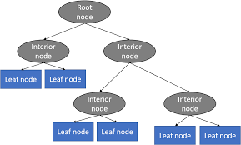
3. DecisionTreeRegressor Model -
Decision Tree is a decision-making tool that uses a flowchart-like tree structure or is a model of decisions and all of their possible results, including outcomes, input costs, and utility.
Decision-tree algorithm falls under the category of supervised learning algorithms. It works for both continuous as well as categorical output variables.
The branches/edges represent the result of the node and the nodes have either:
Conditions [Decision Nodes]
Result [End Nodes]

Slide 13
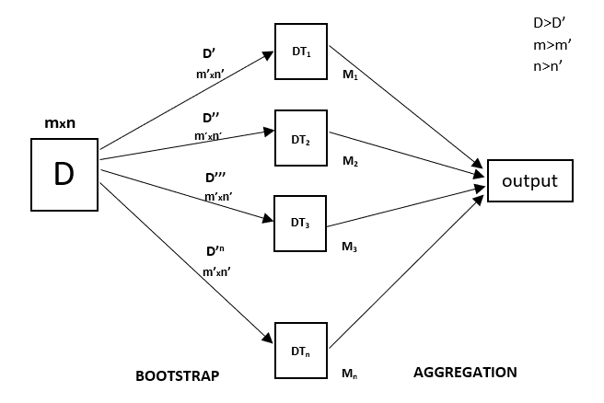
4. RandomForestRegressor Model -
A Random Forest is an ensemble technique capable of performing both regression and classification tasks with the use of multiple decision trees and a technique called Bootstrap and Aggregation, commonly known as bagging. The basic idea behind this is to combine multiple decision trees in determining the final output rather than relying on individual decision trees.
Random Forest has multiple decision trees as base learning models. We randomly perform row sampling and feature sampling from the dataset forming sample datasets for every model. This part is called Bootstrap.

Slide 14
5. AdaBoostRegressor -
Adaboost stands for Adaptive Boosting and it is widely used ensemble learning algorithm in machine learning. Weak learners are boosted by improving their weights and make them vote in creating a combined final model. In this post, we'll learn how to use AdaBoostRegressor class for the regression problem. AdaboostRegressor starts fitting the regressor with the dataset and adjusts the weights according to error rate.

Slide 15
6. Extreme Gradient Boosting Regressor -
The results of the regression problems are continuous or real values. Some commonly used regression algorithms are Linear Regression and Decision Trees. There are several metrics involved in regression like root-mean-squared error (RMSE) and mean-squared-error (MAE). These are some key members of XGBoost models, each plays an important role.
RMSE: It is the square root of mean squared error (MSE).
MAE: It is an absolute sum of actual and predicted differences, but it lacks mathematically, that’s why it is rarely used, as compared to other metrics.
XGBoost is a powerful approach for building supervised regression models. The validity of this statement can be inferred by knowing about its (XGBoost) objective function and base learners.

Slide 16
Conclusion
So here 'RandomForest Regression model' is the best model out of all model tested above
which gives score - Training accuracy is 0.9988898736783678
Test accuracy is 0.9556107954545454 , which is the greatest.

